Slide 1
.NET Crypto API
SFS Projekt WS 15/16
Martina Haslehner
Philipp Haider

Slide 2
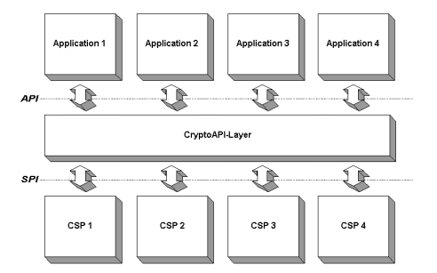
History
CAPI since NT 4.0 (deprecated)
Native and hardware implementations
Can be configured by policies
Managed Wrappers since .NET 1.1 and CAPICOM
CNG since Windows Vista (Bcrypt.dll)
System.Security.Cryptography: Wrappers for the certified native algorithms but also managed implementations
https://www.cdc.informatik.tu-darmstadt.de/reports/reports/vest.diplom.pdf

Slide 3
Algorithm-Variants (System.Security.Cryptography)
[Algo]Managed
mscorlib.dll
[Algo]Crypto-ServiceProvider
[Algo]Cng
CryptoAPI
Bcrypt.dll

Slide 4
NSA Suite-B Cryptography
NSA and NIST recommended (2005)
Algorithms, Block-Sizes, Key-Sizes, …
Available since Windows Vista (CNG)
Suite-A nuclear security
Purpose | Algorithm
Encryption | AES
Digital Signature | EC-DSA
Key Exchange | EC-DH or EC-MQV
Hashing | SHA-2

Slide 5
Demo

Slide 6
License Server (Unsecure)
Get License
Read
Client
Server
License File
License Generator
Write
License
Vulnerability: Spoofing
Mitigation: Signing

Slide 7
License Server (V1)
Comp. Priv. Key
Get License
Read
Read
Client
Server
License File
License Generator
Read
Write
License
Comp. Pub. Key
Vulnerability: Spoofing
Mitigation: Signing

Slide 8
License Server (V2)
Comp. Priv. Key
Get License
Read
Read
Client
Server
License File
License Generator
Read
Read
Write
Read
License
Send Server Pub. Key
Comp. Pub. Key
Server Pub. Key
Server Priv. Key

Slide 9
Thank you!

